Slide 1



The Issue of infertility in Specific medical conditions
Prof.Fadia J Alizzi
Al-Mustansiriyia Medical College
Consultant OBG & RM
Al-Yarmouk Teaching Hospital
Head of Iraqi Fertility Society (IFS)

Slide 2

Objectives
1
The impact of specific medical disease on reproductive medicine & infertility
DM
Thyroid disorders
MS
2
Up to date Management of infertility in theses endocrine and neurological disorders
3
Evidence based medicine in practicing case solving scenario
4
Limitation & controversies of these evidence

Slide 3

The patient with diabetes

Slide 4
Background
Globally, the burden of diabetes is increasing
including women in the reproductive age group
Management of DM is improved nowadays as well as opportunity for IVF treatment
History of infertility may be a risk factor of GDM, particularly in patients receiving treatment for infertility
Insulin resistance, obesity and diabetes mellitus
Are all correlated to affect fertility
The known worse impact of DM on pregnancy outcome

Slide 5
DM – TYPE 2
Background
the prevalence of obesity is increasing due to changing dietary and
lifestyle patterns, thus raising the incidence of
Type 2 diabetes during the reproductive years.
There is an association between Type 2 diabetes and fertility
alterations in the length of the menstrual cycle, and the
age of onset of menopause
Insulin resistance, obesity and diabetes mellitus
strongly correlate with PCOS
Obesity is common in both PCOS and Type 2 diabetic women.
Studies show that obese women seeking pregnancy experience longer
times to conception, unrelated to age and to cyclic regularity

Slide 6
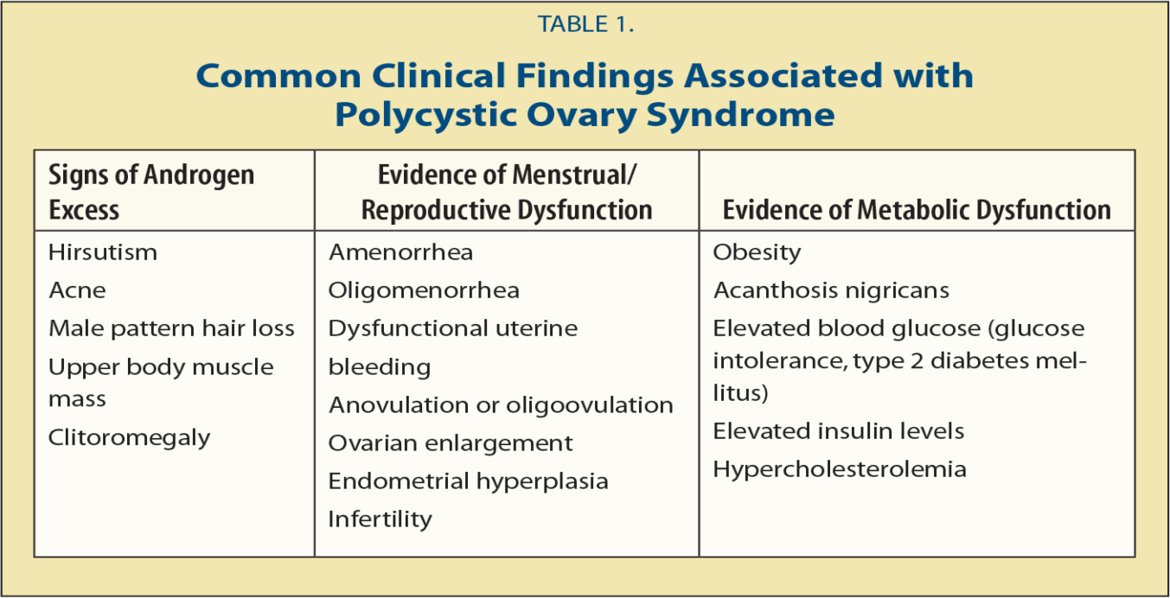
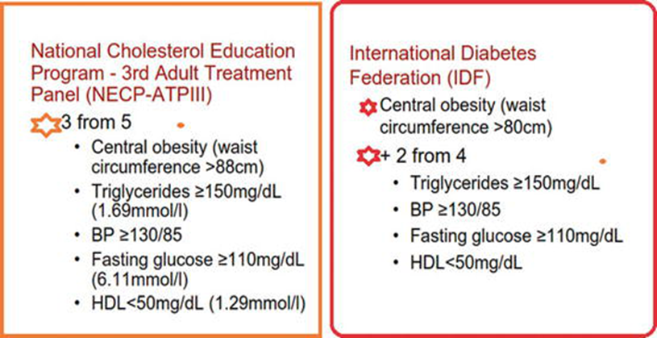
A 32-years-old woman (BMI 29 kg/m2), attends infertility clinic with primary infertility of 1year duration.
She had history of hirsutism and oligomenorrhoea with PCOM on TV/US.
As part of her initial diagnostic work-up:
Her partner SFA is normal
HSG is normal
she was identified to have Type 2 diabetes Her recent HbA1c was 7.7% (DCCT) (IFCC 60.7 mmol/ mol ).
Her total cholesterol was 6.2 mmol/l and her blood pressure was 144/86 mmHg.
How to interpret data
PCOS woman with history of 1 year primary infertility ( type A phenotype )
high BMI
Type 2 diabetes with high HbA1c
high Cholesterol & BP

Slide 7
A 32-years-old woman (BMI 29 kg/m2), attend infertility clinic with primary infertility of 1year duration.
She had history of hirsutism and oligomenorrhoea with PCOM on TV/US.
As part of her initial diagnostic work-up:
Her partner SFA is normal
HSG is normal
she was identified to have Type 2 diabetes Her recent HbA1c was 7.7% (DCCT) (IFCC 60.7 mmol/ mol ).
Her total cholesterol was 6.2 mmol/l and her blood pressure was 144/86 mmHg.
Preconception care (PCC)
Pre-pregnancy counselling
Hyperglycemia in early pregnancy increases the risk of
congenital abnormalities by 9 fold
There is a 5 fold increase in the rate of cardiovascular abnormalities
2 fold increase in the rate of neural tube and urinary tract defects.
Congenital defects and preterm births were the main contributors to the high rate of perinatal mortality
Pre-pregnancy counseling
Take a higher dose of folic acid
lifestyle modification
multidisciplinary medical care
substituting teratogenic medications for safer ones
Check the patient vaccination (rubella or MMR)

Slide 8
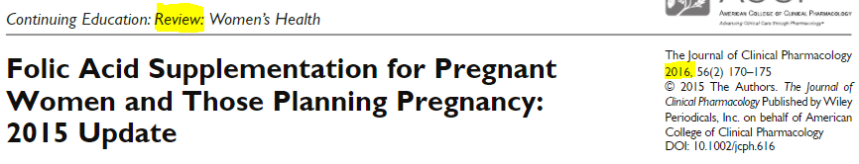
A 32-years-old woman (BMI 29 kg/m2), attend infertility clinic with primary infertility of 1year duration.
She had history of hirsutism and oligomenorrhoea with PCOM on TV/US.
As part of her initial diagnostic work-up:
Her partner SFA is normal
HSG is normal
she was identified to have Type 2 diabetes Her recent HbA1c was 7.7% (DCCT) (IFCC 60.7 mmol/ mol ).
Her total cholesterol was 6.2 mmol/l and her blood pressure was 144/86 mmHg.
PCC
5 mg Folic a supplementation
Pre-pregnancy counselling
Take a higher dose of folic acid
lifestyle modification
multidisciplinary medical care
substituting teratogenic medications for safer ones
Check the patient vaccination (rubella or MMR)
Diabetes
Several studies have documented a 10-fold increase in the incidence of NTD among women with poorly controlled DM during the ﬁrst trimester of pregnancy.
Since periconceptional control of DM in pregnant women is difﬁcult, the use of high-dose folic acid supplementation may decrease the risk for having a baby with NTD.

Slide 9

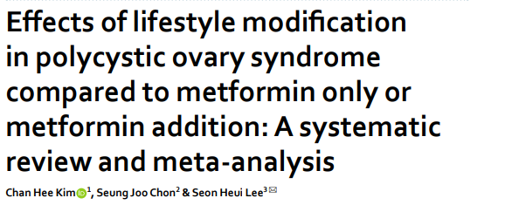
A 32-years-old woman (BMI 29 kg/m2), attend infertility clinic with primary infertility of 1year duration.
She had history of hirsutism and oligomenorrhoea with PCOM on TV/US.
As part of her initial diagnostic work-up:
Her partner SFA is normal
HSG is normal
she was identified to have Type 2 diabetes Her recent HbA1c was 7.7% (DCCT) (IFCC 60.7 mmol/ mol ).
Her total cholesterol was 6.2 mmol/l and her blood pressure was 144/86 mmHg.
PCC
LSM
Pre-pregnancy counselling
Take a higher dose of folic acid
lifestyle modification
multidisciplinary medical care
substituting teratogenic medications for safer ones
Check the patient vaccination (rubella or MMR)
lifestyle intervention is more effective than the standard care regarding the glycaemic control of type 2 diabetic patients, particularly when there is a weight loss
stop smoking
having a healthy diet
being physically active/exercising
losing weight
LSM tends to have more benefits
LSM should be the primary recommendation in women with PCOS before prescribing metformin

Slide 10
A 32-years-old woman (BMI 29 kg/m2), attend infertility clinic with primary infertility of 1year duration.
She had history of hirsutism and oligomenorrhoea with PCOM on TV/US.
As part of her initial diagnostic work-up:
Her partner SFA is normal
HSG is normal
she was identified to have Type 2 diabetes Her recent HbA1c was 7.7% (DCCT) (IFCC 60.7 mmol/ mol ).
Her total cholesterol was 6.2 mmol/l and her blood pressure was 144/86 mmHg.
PCC
MDT
Pre-pregnancy counselling
Take a higher dose of folic acid
lifestyle modification
multidisciplinary medical care
substituting teratogenic medications for safer ones
Check the patient vaccination (rubella or MMR)
MDT include endocrinologist, obstetrician, dietitian and midwives specialized in diabetes
Get the HbA1C to the recommended level
regular screening for cardiovascular risk factors is essential, including measurements of blood pressure, waist circumference, BMI and lipid profile

Slide 11
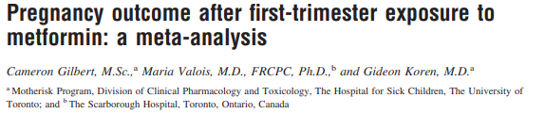

A 32-years-old woman (BMI 29 kg/m2), attend infertility clinic with primary infertility of 1year duration.
She had history of hirsutism and oligomenorrhoea with PCOM on TV/US.
As part of her initial diagnostic work-up:
Her partner SFA is normal
HSG is normal
she was identified to have Type 2 diabetes Her recent HbA1c was 7.7% (DCCT) (IFCC 60.7 mmol/ mol ).
Her total cholesterol was 6.2 mmol/l and her blood pressure was 144/86 mmHg.
PCC
Metformin
Pre-pregnancy counselling
Take a higher dose of folic acid
lifestyle modification
multidisciplinary medical care
substituting teratogenic medications for safer ones
Check the patient vaccination (rubella or MMR)
there is no evidence of an increased risk for major malformations
metformin and glibenclamide can be used during pregnancy, but only if the benefit of an improved glycaemic control outweighs the potential risk on the fetus
in women with PCOS, the use of metformin has been shown to reduce the number of early pregnancy miscarriages and reduces the possibility of gestational diabetes

Slide 12
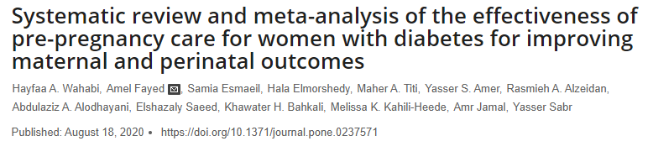
Conclusion
PCC for women with pre-gestational type 1 or type 2 diabetes mellitus is effective in improving rates of congenital malformations. In addition, it may improve the risk of preterm delivery and admission to NICU.
PCC probably reduces maternal HbA1C in the first trimester of pregnancy, perinatal mortality and SGA.
There is uncertainty regarding the effects of PCC on early booking for antenatal care or maternal hypoglycemia during the first trimester of pregnancy. PCC has little or no effect on other maternal and perinatal outcomes.

Slide 13
A 32-years-old woman (BMI 29 kg/m2), attend infertility clinic with primary infertility of 1year duration.
She had history of hirsutism and oligomenorrhoea with PCOM on TV/US.
As part of her initial diagnostic work-up:
Her partner SFA is normal
HSG is normal
she was identified to have Type 2 diabetes Her recent HbA1c was 7.7% (DCCT) (IFCC 60.7 mmol/ mol ).
Her total cholesterol was 6.2 mmol/l and her blood pressure was 144/86 mmHg.
Progress and outcome of the case
After four months on metformin therapy and attempts to reduce her weight by adhering to a strict diet, the patient's HbA1c improved to 5.6 %.
NICE guidelines state that the HbA1c level should be below 6.1% for a safe pregnancy to occur.
Pregnancy is not recommended if the level is above 10%.
Any reduction of HbA1c towards 6.1% would help to reduce the risk of congenital malformations.
A combined approach of weight loss, healthy diet, exercise Programme and, if necessary, a hypoglycemic agent (such as metformin) would help lower her blood sugar levels and
Her 24-h ambulatory blood pressure revealed a mean systolic pressure of 126 mmHg and diastolic of 78 mmHg, therefore meaning she was not started on any antihypertensive medications.
Labetalol, methyldopa and hydralazine are deemed safer in pregnancy.
Women should not conceive on statins due their potential teratogenic effects.
She was referred to the local fertility center for further investigations and management of her infertility.

Slide 14
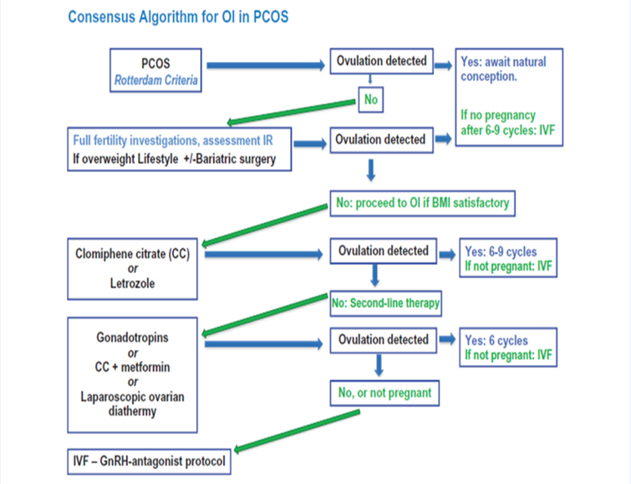
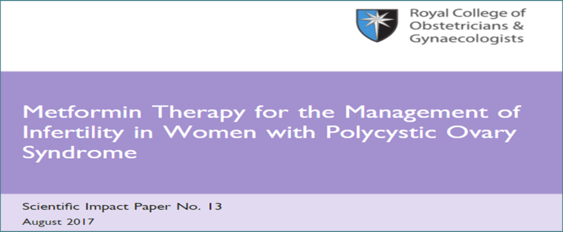
A 32-years-old woman (BMI 29 kg/m2), attend infertility clinic with primary infertility of 1year duration.
She had history of hirsutism and oligomenorrhoea with PCOM on TV/US.
As part of her initial diagnostic work-up:
Her partner SFA is normal
HSG is normal
she was identified to have Type 2 diabetes Her recent HbA1c was 7.7% (DCCT) (IFCC 60.7 mmol/ mol ).
Her total cholesterol was 6.2 mmol/l and her blood pressure was 144/86 mmHg.
Metformin appears to have a limited role in improving reproductive outcomes
may be a beneﬁt :
in obese women when combined with clomiphene citrate,
clomiphene citrate resistance
IGT or type II diabetes

Slide 15
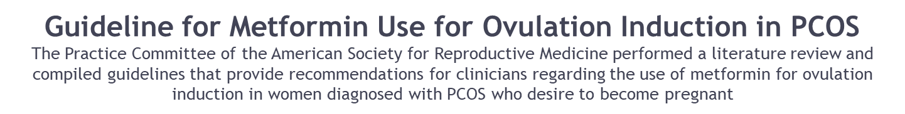
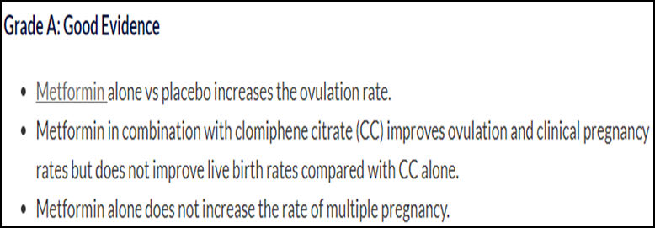
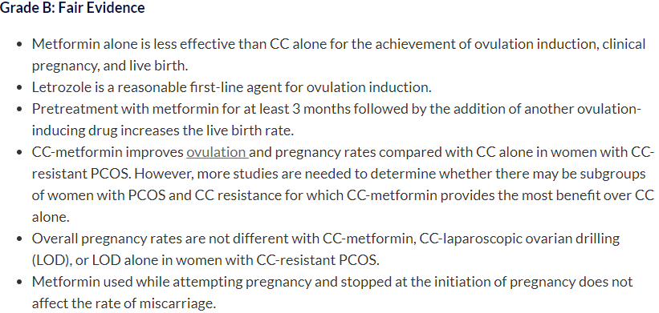
A 32-year-old woman (BMI 29 kg/m2), attend infertility clinic with primary infertility of 1year duration.
She had history of hirsutism and oligomenorrhoea with PCOM on TV/US.
As part of her initial diagnostic work-up:
Her partner SFA is normal
HSG is normal
she was identified to have Type 2 diabetes Her recent HbA1c was 7.7% (DCCT) (IFCC 60.7 mmol/ mol ).
Her total cholesterol was 6.2 mmol/l and her blood pressure was 144/86 mmHg.

Slide 16
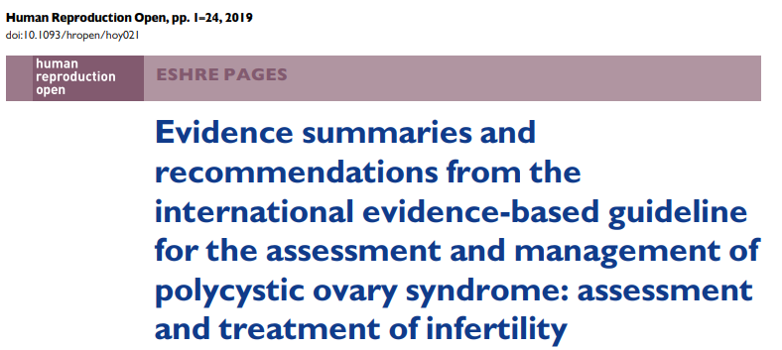
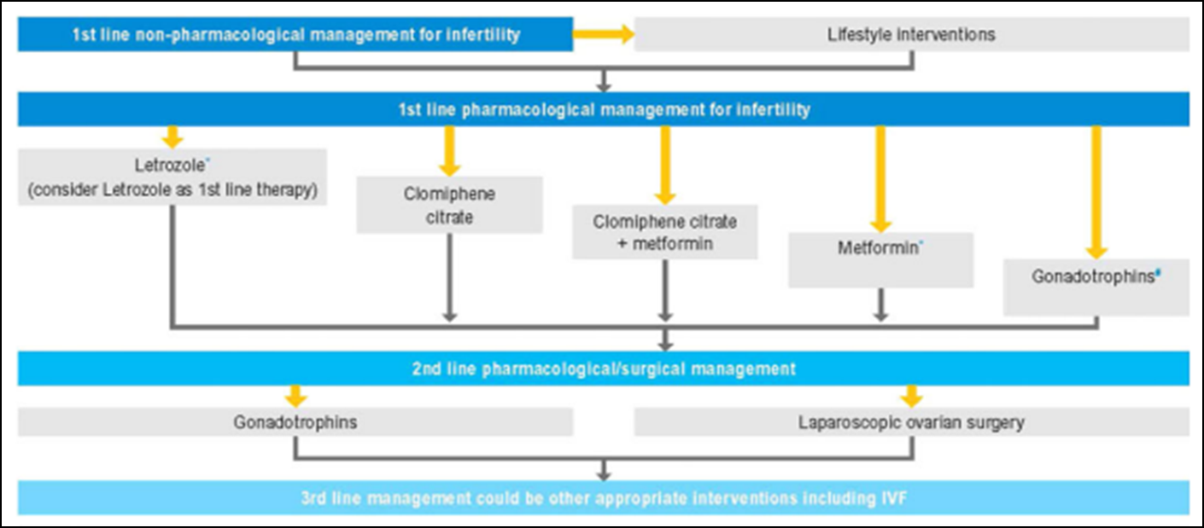
may be a beneﬁt :
in obese women when combined with CC
CC resistance
IGT or type II diabetes

Slide 17

metformin may be beneficial over placebo for LBR
uncertain if metformin plus CC improves LBR compared to CC alone
When metformin was compared with CC, data for live birth were inconclusive, and the findings Results differed by BMI, emphasizing the importance of stratifying results by BMI.
uncertain of the effect of metformin on miscarriage in all three comparisons.

Slide 18
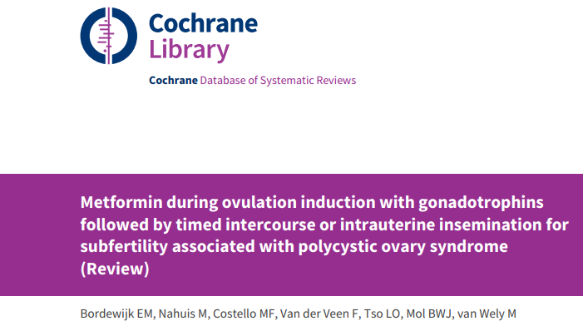
Preliminary evidence suggests that metformin may increase the live birth rate among women undergoing ovulation induction with gonadotrophins.
At this moment, evidence is insufficient to show an effect of metformin on multiple pregnancy rates and adverse events.

Slide 19
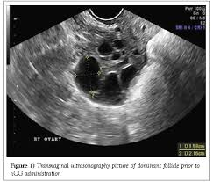

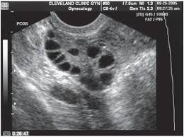
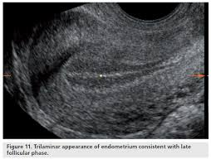
Chronic low dose step up protocol
CD
2-4
CD 15
Gn 5OIU for 14 days
GN 75IU for 7days
To trigger or not ?
We trigger if no more than 2 DF 16-18 mm

Slide 20
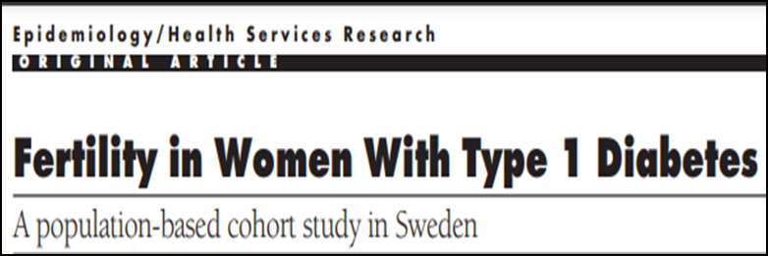
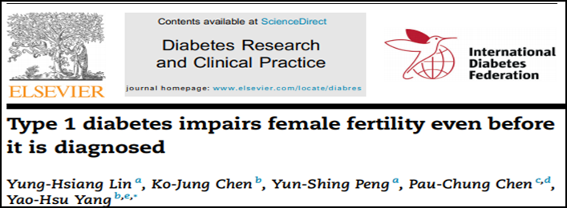
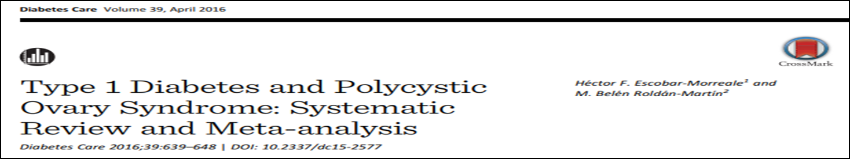
Type 1 DM
Women with type 1 diabetes have reduced fertility, but normalization has improve the outcome.
Type 1 diabetes compromises female fertility, even before it is diagnosed.
Associated hyperthyroidism further reduces fertility.
Blood glucose and thyroid function surveillance in infertile females may allow for an early diagnosis of type 1 diabetes and associated thyroid disease.
PCOS and its related traits are frequent findings in women with type 1 diabetes.
PCOS may contribute to the subfertility Hence, screening for PCOS and androgen excess should be included in current guidelines for the management of type 1 diabetes in women.

Slide 21

A 30-years-old woman with primary subfertility of 3 years and previous failed attempts IUI was reviewed for IVF treatment.
She was known to have type 1 diabetes.
BMI was 24 kg/m2 and HbA1c 12%.
Her partner SFA was normal
She was referred to the endocrinologist for tighter glycemic control, following which IVF treatment was commenced.
On the day of OPU her FBS was 10 mmol/L & HbA1c was 8%.
E2 level before OPU was 10,120 pmol/L and 12 oocytes were retrieved, of which nine fertilized.
She complained of abdominal bloating, nausea and a smelly vaginal discharge from day 5 after the retrieval.
Commencement of COS will affect glycemic control because of the change in hormonal milieu and associated stress.
As with any other diabetic patient undergoing a surgical procedure, the woman will require antibiotic prophylaxis with oocyte retrieval.
As diabetes is a major medical illness, thromboprophylaxis risk assessment should be undertaken and thromboprophylaxis administered if indicated.
Pre-pregnancy counselling
Take a higher dose of folic acid
lifestyle modification
multidisciplinary medical care
substituting teratogenic medications for safer ones
Check the patient vaccination (rubella or MMR)
OHSS should always be ruled out
the woman’s symptoms could be related to infection and she will therefore require infection screening.
Glycemic control should be checked and maintained.

Slide 22
Recommendations
For patients with diabetes undergoing ART, tight glycemic control is associated with normal ovarian response, fertilization and cleavage rates and pre-embryonic development.
Preconception counseling for good glycemic control is the key for good pregnancy outcome
Optimal BMI maintenance is required for better glycemic control and ovarian response.
In patients with diabetes with OPU , antibiotic and thromboprophylaxis precautions should be taken to reduce the risk of infection and thromboembolism

Slide 23

The Patient With Thyroid Disease

Slide 24
Background
The management of women with thyroid disease preconceptually and during pregnancy is important & Adequate treatment and control is associated with good obstetric outcome
Several controversies are there
universal screening of pregnant women for thyroid disease
thresholds at which treatment should be commenced in newly diagnosed subclinical disease
whether to treat euthyroid thyroid peroxidase (TPO) antibody positive women
It should also be noted that reference ranges for thyroid function tests vary according to the laboratory assay, ethnicity of the population and stage of pregnancy

Slide 25
Obstetric complications
Obstetric complications associated with
untreated overt maternal hypothyroidism
Complications associated with uncontrolled
maternal thyrotoxicosis
Miscarriage (1st & 2nd trimester)
Preterm birth
LBW
PIH
Stillbirth
PE
Perinatal death
Anemia
PPH
Maternal thyroid storm (1st & 2nd trimester)
IUGR
Fetal thyrotoxicosis
Maternal CHF
Fetal hypothyroidism
PE
Fetal goiter
Placental abruption
Stillbirth
Preterm delivery
Perinatal death

Slide 26
Important points
Hypothyroid disorder
Hyperthyroid disorder
In iodine replete countries, the incidence of hypothyroidism diagnosed before pregnancy is about 1%
2.5% of pregnant women have subclinical hypothyroidism
Worldwide iodine deficiency remains the leading cause of hypothyroidism.
In affected countries the WHO has recommended routine iodine supplementation to ensure a daily iodine intake of 250 μg during pregnancy and lactation
The transplacental passage of TSH receptor Ab may cause fetal and/or neonatal hyperthyroidism in < 1% of cases while antithyroid drugs can induce fetal hypothyroidism
PTU has not been associated with any teratogenicity
There has been an unproven causal link between carbimazole (or methimazole) and the rare benign scalp condition of aplasia cutis, esophageal atresia, choanal atresia and dysmorphic facial features in the fetus
Because PTU is associated with the rare SE of severe liver impairment, some have advocated converting treatment back to carbimazole in the 2nd 3rd trimester

Slide 27
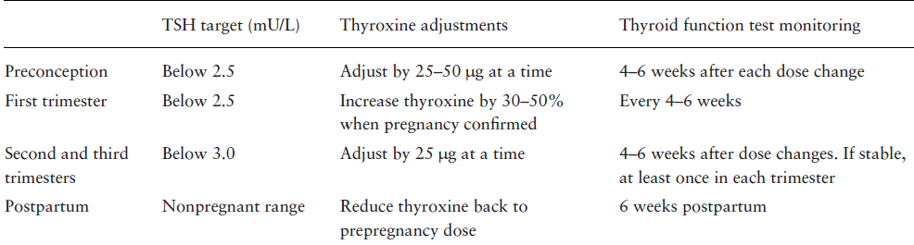
Recommendations for thyroid function monitoring in pregnancy in the absence of trimester-specific reference ranges
Just as in pregnancy, thyroxin requirements are also increased with COS during ART. Thus, women already on thyroxin replacement should also have a dosage increase in the region of 30% at the start of such infertility treatment.

Slide 28
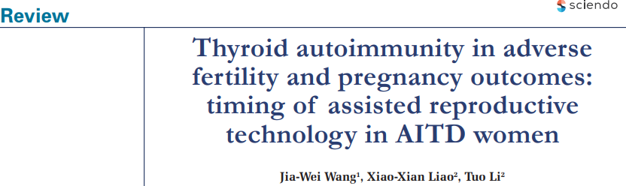



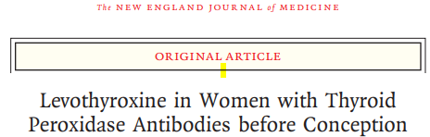
Thyroid autoimmunity
TAA and following overt thyroid dysfunction lead to infertility and pregnancy and neonatal complications.
it seems reasonable to screen for TSH concentrations and thyroid antibodies (including TPOAb and TgAb) in infertile women attempting spontaneous or assisted conception.
it is not clearly recommended or opposed whether ATA-positive women with normal thyroid function need levothyroxine during pregnancy
it confirmed the known increased risk of miscarriage and found a decreased chance of live birth in patients with positive thyroid autoantibodies
TAI does not appear to have an impact on IVF/ICSI outcome in terms of fertilisation, implantation and clinical pregnancy
The use of levothyroxine in euthyroid women with thyroid peroxidase antibodies did not result in a higher rate of live births than placebo
2019

Slide 29
the American Thyroid Association guidelines
Pregnant woman with a TSH value of 2.5–10.0 mIU/L should detect the level of TPOAb, and the level of TSH before entering the ART treatment should not exceed 2.5 mIU/L.
Because of the increased risk of hypothyroidism in AITD women during pregnancy, the American Thyroid Association guidelines recommend that women with AITD evaluate TSH concentrations every four weeks in mid-pregnancy

Slide 30
A 35-years-old woman with unexplained infertility is about to undergo IVF treatment. She has been diagnosed with hypothyroidism 2 years ago. She has maintained normal TFT results with levothyroxine 100μg/day for the past 18 month and has been clinically euthyroid. Her most recent test showed a TSH level of 3.8 mU/L (normal range: 0.4–4.2 mU/L) and a free thyroxin (T4) level of 12.2 pmol/L (9.5–20 pmol/L).
increase her thyroxin dose by 25 μg at a time, with TFT performed 4–6 weeks after each dose increment until the TSH concentration is below 2.5 mU/L, before commencing IVF treatment.
At the start of COS , she should be advised to increase her dose of thyroxin by a further 25 μg.
As soon as she has a positive pregnancy test, she should be advised to again increase thyroxin by a further 25 μg (30–50% of her pre-pregnancy dose).
At the same time she should also have her TSH and free T4 concentrations tested and if results suggest inadequate thyroid hormone replacement, a further dose increase of 25 μg may be appropriate.
TFT checks made 4–6 weeks later on every occasion

Slide 31
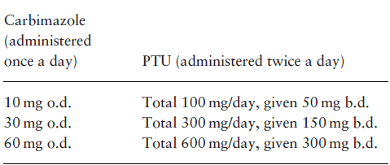
A 26-years-old woman was diagnosed with Graves’ disease 2 years ago & she is on carbimazole treatment, her disease became quiescent but recurred 6 months ago. She is currently on carbimazole 30 mg/day and is clinically euthyroid with a small soft diffuse palpable goiter. She attend infertility center for ICSI due to her partner SFA - oligozoospermia. TFT performed within the last month showed a TSH level of 0.03 mU/L (0.4–4.2 mU/L), free T4 of 18 pmol/L (9–20 pmol/L) and free T3 of 6 pmol/L (3.5–6.8 pmol/L).
Before ICSI her treatment should be converted from carbimazole to PTU.
TFT should be checked during COS. & 4–6 weeks after each dosage change.
The aim preconceptually and during pregnancy is to maintain the free T4 level in the upper third of the normal to protect the fetus from hypothyroidism .
It is common to find that TSH concentrations remain low or fully suppressed and is thus not a good indicator of disease control.
During COS , PTU dosage may need to be reduced because of increased thyroxin requirements.
The conversion of carbimazole to
PTU treatment in hyperthyroidism
Graves’ disease usually go to remission in the second half of pregnancy and PTU can often be tailed off or stopped
There is a 50% chance that Graves disease will flare postpartum and TFT should be performed over the course of the following 6– 9 months.

Slide 32

MS and conception

Slide 33
Background
Woman with MS , fertility could be impaired due to:
health issues (including the effect of therapy) leading to reduced ability to conceive
a decision to avoid pregnancy because of disability
POI could possibly arise in women with MS because they have a genetic predisposition to develop autoimmune disease
reduced ovarian reserve could be due to a neuroendocrine effect of MS.

Slide 34
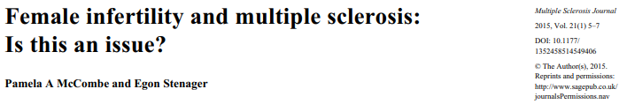
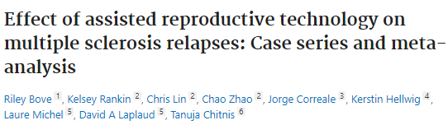

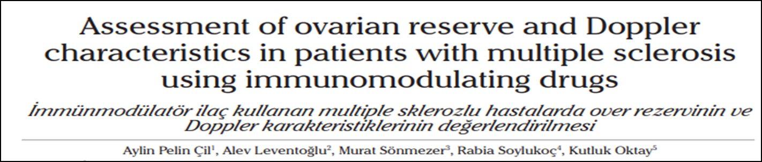
What does evidence say ?
fertility may be an issue in MS. This has clinical implications because if fertility is reduced, this may lead women to use ART, which is of concern, because this has been associated with relapses of MS
The meta-analysis confirmed an increased ARR after ART
diminished ovarian volume & follicular reserve in MS patients using immuno-modulating drugs
further studies are required to elucidate whether compromised ovarian reserve in MS patients is due to drugs or the disease itself
2015
2009

Slide 35


